Slide 1
Collective Worship
Mary the Mother of God

Slide 2
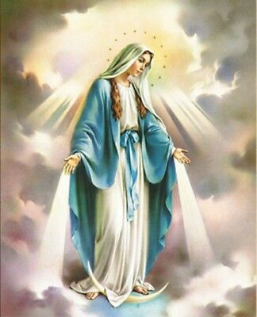
May is the month of Mary.

Slide 3
A reading from the Gospel of Luke
God sent the angel Gabriel to the town of Nazareth in Galilee with a message for a virgin named Mary. She was engaged to Joseph from the family of King David.
The angel greeted Mary and said,
“You are truly blessed! The Lord is with you.”
Mary was confused by the angel’s words and wondered what they meant. Then the angel told Mary, “Don’t be afraid! God is pleased with you, and you will have a son. His name will be Jesus. He will be great and will be called the Son of God Most High. The Lord God will make him king, as his ancestor David was. He will rule the people of Israel forever, and his kingdom will never end.”
Mary asked the angel, “How can this happen? I am not married!”

Slide 4
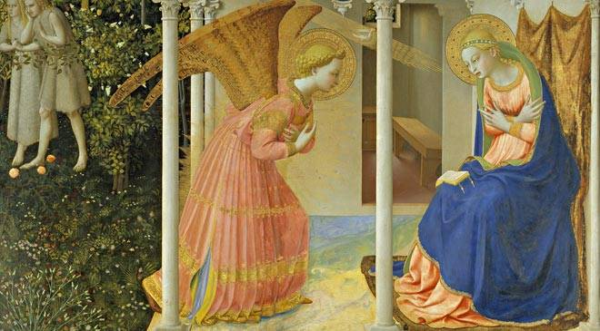
The angel answered, “The Holy Spirit will come down to you, and God’s power will come over you. So your child will be called the holy Son of God. Your relative Elizabeth is also going to have a son, even though she is old. No one thought she could ever have a baby, but in three months she will have a son. Nothing is impossible for God!”
Mary said, “I am the Lord’s servant! Let it happen as you have said.”
And the angel left her.

Slide 5
Mary has a special place in the Church.
Catholics believe that Mary was born and lived without any sin – this is what it means when Mary is called ‘The Immaculate Conception’. Catholics believe that Mary was chosen by God to be the mother of Jesus before she was even born … but she still needed to say ‘Yes’.
Catholics believe that Mary was ‘assumed’ into heaven – this means taken into heaven without having died on earth.

Slide 6
A number of different titles have been given to Mary. Here are some:
Our Lady, Star of the Sea
Our Lady, Seat of Wisdom
Our Lady, Queen of Heaven
Our Lady, Queen of Peace
Our Lady, Cause of our Joy
Our Lady, Morning Star
Our Lady, Help of Christians
Do you have a favourite name for Mary? Which one, and why?

Slide 7
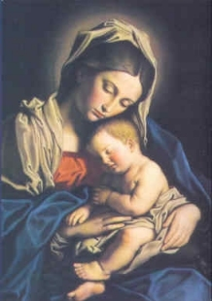
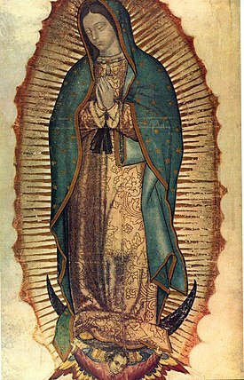
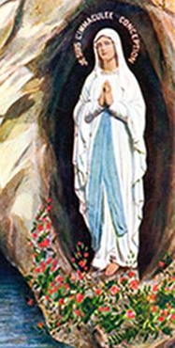
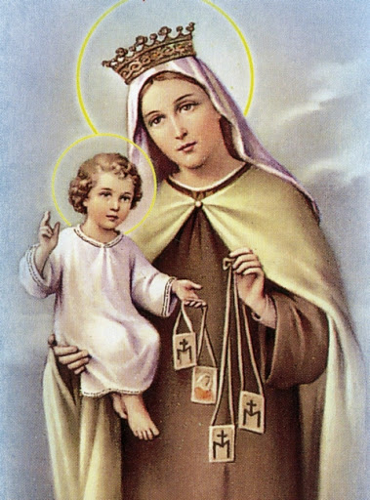
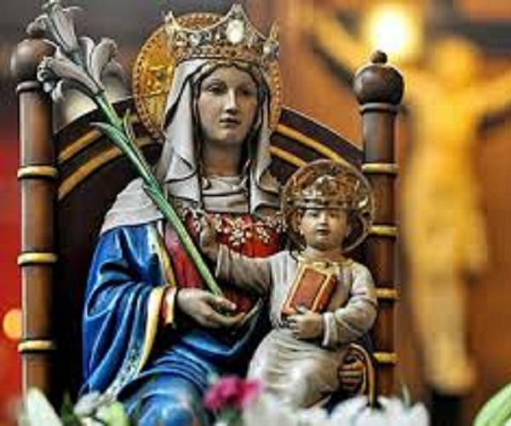
There are many different images of Mary. What does each of these images tell you about Mary?

Slide 8
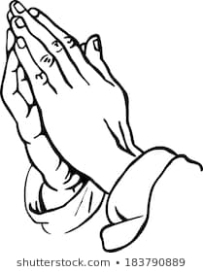
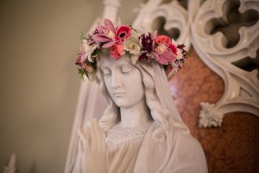
Mary is honoured through two particular prayers.

Slide 9
Hail Mary, full of grace,
The Lord is with thee.
Blessed art thou amongst women
And blessed is the fruit of thy womb Jesus.
Holy Mary, Mother of God,
Pray for us sinners now
And at the hour of our death.
Amen.

Slide 10
Hail, Holy Queen,
Mother of Mercy,
Hail, our life, our sweetness and our hope.
To thee do we cry,
Poor banished children of Eve:
To thee do we send up our sighs,
Mourning and weeping in this vale of tears.
Turn then, most gracious Advocate,
Thine eyes of mercy towards us
And after this, our exile,
Show to us the blessed fruit of thy womb, Jesus.
O clement, O loving, O sweet Virgin Mary.

Slide 11
The month of May lasts for 31 days.
How could you try to follow Mary’s example during the month of May?
What could you say ‘Yes’ to doing … even though you might find it a bit difficult?

Slide 12
Prayer
Let us be still and silent for one minute. God gave Mary a very special job to do, but He has jobs for each of us too. Let us ask God to help us to do the jobs He would like us to do. Let us ask Him to give us courage, determination and perseverance. Amen.

Slide 13
A hymn in honour of Mary to listen to and enjoy … or join in with.
Don’t forget to finish with the prayer on the next (last) slide.

Slide 14
Share a prayer
Dear God, thank you choosing Mary to be our role model and our inspiration. Thank you for blessing Mary with the courage to say ‘Yes’ to your call. Help us, Lord, to follow her example in the way that we love and serve God, and love and serve one another.
Amen

