Slide 1
Collective Worship
Summer 2
Week 4
12th Sunday in Ordinary Time: Year A

Slide 2
Monday

Slide 3
In the name
of the Father,
and of the Son
and of the
Holy Spirit
Amen

Slide 4
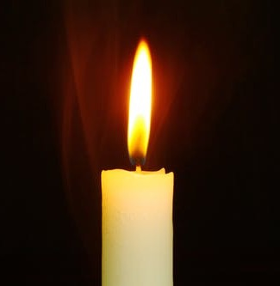
Let the light of
Jesus
shine in our hearts.

Slide 5
Today is the feast of Saints John Fisher and Thomas More. John Fisher was born in Yorkshire, in 1469, and became Bishop of Rochester in Kent. He was well- known as a man of learning, and had written several books. Bishop John Fisher was asked to study the “problem” of the marriage of King Henry VIII to Catherine of Aragon. The king wanted to divorce her after 18 years of marriage, in order to have a male successor to the throne. Henry VIII wanted John Fisher and Thomas More (and others) to tell him that he was free to marry again. Both John Fisher and Thomas More were executed for opposing King Henry VIII, who declared himself to be Head of the Church in England.
Let’s listen to the Gospel reading from Mass for today, their Feast day…

Slide 6
A reading from the Holy Gospel according to Matthew:
Glory to you, O Lord.
⁴ Jesus answered, “Watch out, and do not let anyone fool you. ⁵ Many men, claiming to speak for me, will come and say, ‘I am the Messiah!’ and they will fool many people. ⁶ You are going to hear the noise of battles close by and the news of battles far away; but do not be troubled. Such things must happen, but they do not mean that the end has come. ⁷ Countries will fight each other; kingdoms will attack one another. There will be famines and earthquakes everywhere. ⁸ All these things are like the first pains of childbirth.
⁹ “Then you will be arrested and handed over to be punished and be put to death. Everyone will hate you because of me. ¹⁰ Many will give up their faith at that time; they will betray one another and hate one another. ¹¹ Then many false prophets will appear and fool many people. ¹² Such will be the spread of evil that many people's love will grow cold. ¹³ But whoever holds out to the end will be saved.
The Gospel of the Lord…Praise to you, Lord Jesus Christ.

Slide 7
Sacred Silence…
Let us reflect on how St Thomas More and St John Fisher held onto their faith to the end.

Slide 8
Sometimes when we pray for something, we might think it’s an easy way for some- thing to happen, presuming that God will do something without us having to work at it. If I pray for “peace in our world” then I am really also committing myself to start making peace around me.
Saint Thomas More put this in a simple way when he said:
“The things, good Lord, that we pray for, give us your grace to work for.”
How will you make a change for something you believe in?

Slide 9
We’ll make those words our prayer to- day, as we say:
“The things, good Lord, that we pray for, give us your grace to work for.”

Slide 10
In the name
of the Father,
and of the Son
and of the
Holy Spirit
Amen

Slide 11
Tuesday

Slide 12
In the name
of the Father,
and of the Son
and of the
Holy Spirit
Amen

Slide 13
Let the light of
Jesus
shine in our hearts.

Slide 14
We are in Ordinary Time.
In today’s Gospel reading we will hear Jesus reminding us that we should not be afraid, and telling us just how well God knows us.

Slide 15
A reading from the Gospel of Matthew
Jesus said to his disciples:
“Don’t be afraid! Everything that is hidden will be found out, and every secret will be known.
Whatever I say to you in the dark, you must tell in the light. And you must announce from the housetops whatever I have whispered to you.
Aren’t two sparrows sold for only a penny? But your Father knows when any one of them falls to the ground. Even the hairs on your head are counted. So don’t be afraid! You are worth much more than many sparrows.”

Slide 16
In the first two parts of the reading there are two very short but very important words.
WILL
MUST

Slide 17
When Jesus says that something WILL happen, He is making a promise.
Everything about God that we do not understand at the moment, one day we WILL. God already knows everything about us, and one day we WILL know God just as well. That is a promise from Jesus.

Slide 18
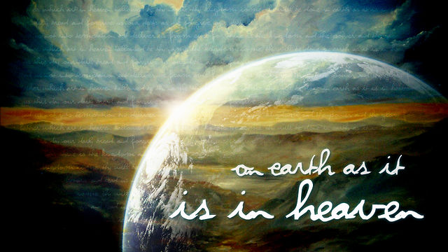
When Jesus says we MUST do something, He is giving an instruction. In this reading Jesus is giving an instruction that we MUST talk about Jesus and share His Good News with other people. It is up to us to carry on Jesus’ work on earth.

Slide 19
Think for a few moments.
If you could ask God any question, what would it be? (You can ask God any question, any time … Jesus warns us that we might have to wait to be able to understand God’s answer).

Slide 20
Think for a few moments.
When do you talk about God?
Apart from through your words, how else could other people learn about God from you?
How can your actions help other people learn about God?

Slide 21
Do you know how many hairs you have on your head?
It would be impossible for us to count the number of hairs on our head. But for God, anything is possible.

Slide 22
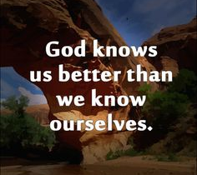
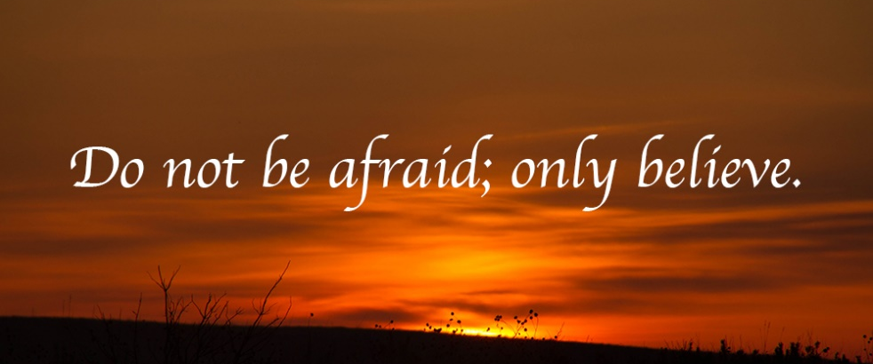
Jesus tells us that God even knows the number of hairs on our heads to teach us that God knows us even better than we know ourselves.
… and God says, ‘Do not be afraid’.

Slide 23
God is telling us not to be afraid, because He knows everything about us, and cares for us more than anything else in the world.

Slide 24
In all our lives there are times when we feel nervous or afraid about something. It is absolutely normal to feel afraid from time to time. Maybe even now, there is something that you are feeling worried about. If there is … you could talk to God about it now.
God really wants to share our worries with Him, so that He can help us not to be afraid. If we talk with Jesus about the things that worry us He can give us comfort, confidence and strength to get through that difficult time. God does not want us to feel on our own.
On the next slide there is a version of a famous poem, written to help us think about God always being with us, always helping us.

Slide 25
Footprints in the Sand
One night I dreamed I was walking along the beach with the Lord Scenes from my life flashed across the sky, In each, I noticed footprints in the sand. Sometimes there were two sets of footprints; other times there was only one. During the lowest times of my life I could see only one set of footprints, so I said, "Lord, you promised me, that you would walk with me always. Why, when I have needed you most would you leave me?" The Lord replied, "My precious child, I love you and would never leave you. The times when you have seen only one set of footprints, it was then that I carried you."

Slide 26
Dear Lord,
Thank you for being with me at all times in my life. I know that if I turn to you, you will take away my fears and anxieties.
You know me better than I know myself. I pray that one day I will know you as well as you know me.
Help me Lord, always to trust in you. Help me Lord, to do your work on earth.
Amen.

Slide 27
Here is a hymn to listen to or join in with: ‘Be Not Afraid.’ This is a lovely version, recorded during lockdown.

Slide 28
[Verse 1] You shall cross the barren desert But you shall not die of thirst You shall wander far in safety Though you do not know the way You shall speak your words in foreign lands And all will understand You shall see the face of God and live [Chorus] Be not afraid I go before you always Come follow me And I will give you rest [Verse 2] Blessed are your poor For the kingdom shall be theirs Blessed are you that weep and mourn For one day you shall laugh
And if wicked men insult and hate you all because of me Blessed, blessed are you

Slide 29
In the name
of the Father,
and of the Son
and of the
Holy Spirit
Amen

Slide 30
Wednesday
Today is the Birthday of Saint John the Baptist and is a feast day.

Slide 31
In the name
of the Father,
and of the Son
and of the
Holy Spirit
Amen

Slide 32
Let the light of
Jesus
shine in our hearts.

Slide 33
A reading from the holy Gospel according to Luke....Glory to you, O Lord.
⁵⁷ The time came for Elizabeth to have her baby, and she gave birth to a son. ⁵⁸ Her neighbours and relatives heard how wonderfully good the Lord had been to her, and they all rejoiced with her.
⁵⁹ When the baby was a week old, they came to circumcise him, and they were going to name him Zechariah, after his father. ⁶⁰ But his mother said, “No! His name is to be John.”
⁶¹ They said to her, “But you don't have any relative with that name!” ⁶² Then they made signs to his father, asking him what name he would like the boy to have.
⁶³ Zechariah asked for a writing pad and wrote, “His name is John.” How surprised they all were! ⁶⁴ At that moment Zechariah was able to speak again, and he started praising God. ⁶⁵ The neighbours were all filled with fear, and the news about these things spread through all the hill country of Judea. ⁶⁶ Everyone who heard of it thought about it and asked, “What is this child going to be?” For it was plain that the Lord's power was upon him.

Slide 34
⁸⁰ The child grew and developed in body and spirit. He lived in the desert until the day when he appeared publicly to the people of Israel.
The Gospel of the Lord….Praise to you, Lord Jesus Christ.
A hymn about John the Baptist to listen or join in with.
https://www.youtube.com/watch?v=N2_30G2fJmU

Slide 35
Intercessions
John the Baptist was called the Prophet of the Most High, to go before the Lord and prepare a way for Christ. Let us pray.
For all who prepare pathways for God in our world.
O God hear our prayer
For all who, like John the Baptist; St John Henry Newman and ourselves who are called to participate in God’s mission. O God hear our prayer
For those in authority in the world who speak out for truth and justice.
O God hear our prayer
For young people seeking direction in their lives and relationships.
O God hear our prayer
For those who becomes a voice for the voiceless .
O God hear our prayer
For all who have died or are sick.
O God hear our prayer
Leader In the company of John the Baptist we pray.. Our Father

Slide 36
John, was one of the
first people to recognise Jesus.
How could you recognise
the goodness of Jesus in your friends and family?
Click the link to discover more about the painting.
https://www.nationalgallery.org.uk/paintings/piero-della-francesca-the-baptism-of-christ

Slide 37
In the name
of the Father,
and of the Son
and of the
Holy Spirit
Amen

Slide 38
Thursday

Slide 39
In the name
of the Father,
and of the Son
and of the
Holy Spirit
Amen

Slide 40
Let the light of
Jesus
shine in our hearts.

Slide 41
Let’s sing ‘Our God is a great big God’ together.
https://www.youtube.com/watch?v=eaXPXWBcE3I

Slide 42
Responsorial Psalm
Psalm 138(139):1-3,13-15
Everyone says the response in bold.
I thank you for the wonder of my being.
O Lord, you search me and you know me,
you know my resting and my rising,
you discern my purpose from afar.
You mark when I walk or lie down,
all my ways lie open to you.
I thank you for the wonder of my being.
For it was you who created my being,
knit me together in my mother’s womb.
I thank you for the wonder of my being,
for the wonders of all your creation.
I thank you for the wonder of my being.
Already you knew my soul,
my body held no secret from you
when I was being fashioned in secret
and moulded in the depths of the earth.
I thank you for the wonder of my being.
Reflection
https://www.youtube.com/watch?v=3lR18lqm_I0

Slide 43
This is a simple method of prayer attributed to Pope Francis, patron of Mission Together, while he was Archbishop of Argentina. By using the fingers on our hands, the prayer encourages us to see how, through God’s love, we are connected to all people and concern for the needs of others is part of who we are.

Slide 45
In the name
of the Father,
and of the Son
and of the
Holy Spirit
Amen

Slide 46
Friday

Slide 47
In the name
of the Father,
and of the Son
and of the
Holy Spirit
Amen

Slide 48
Let the light of
Jesus
shine in our hearts.

Slide 49
3 minute retreat
Click on the link and play the video – it will guide you through scripture and prayer.
https://www.loyolapress.com/3-minute-retreats-daily-online-prayer/?utm_source=ignsp&utm_medium=blog&utm_campaign=ignatian

Slide 50
In the name
of the Father,
and of the Son
and of the
Holy Spirit
Amen

