Slide 1
Reception
Friends Topic

Slide 2
Early Years
RECONCILIATION – INTER-RELATING
Come and See for yourself
EXPLORE
Networks of friendships and relationships enable human beings to live together. When a child’s power to reach out, trust and make friends is diminished, they may suffer the effects for a lifetime. Both children and adults have to discover their ability to reach out and repair what has been damaged.
If human beings are to live together in relationships, there is always need for reconciliation.
Recall a time when you were reconciled to someone else.
What or who made the reconciliation possible?
How might that person have felt?
How did you feel?
REVEAL
Christians believe that, in Jesus Christ, the world has been reconciled to God. Through and in Christ, every human being is offered the power to reach out in forgiveness and peace, to receive and to offer reconciliation.
Background notes for parents

Slide 3
Word of God
St. Paul in his letter to the Ephesians, wrote:
“But now in Christ Jesus, you that used to be so far apart from us have been brought very close, by the blood of Christ. For he is the peace between us, and has made the two into one and broken down the barrier which used to keep them apart, actually destroying in his own person the hostility caused by the rules and decrees of the Law.” Ephesians 2:14-15
How can the example of Christ bring people closer together?
How does his example of making peace help you?
Catechism of the Catholic Church
“It is called the Sacrament of Reconciliation, because it imparts to the sinner the love of God who reconciles: ‘Be reconciled to God’. He who lives by God’s merciful love is ready to respond to the Lord’s call: ‘Go; first be reconciled to your brother’...
Indeed the Sacrament of Reconciliation with God brings about a true ‘spiritual resurrection’, restoration of the dignity and blessings of the life of the children of God, of which the most precious is friendship with God.” CCC1424, 1468
RESPOND
Are there any areas in the life of the school where you think it might be necessary to restore broken relationships?
What opportunities are there in the classroom for restoring relationships when misunderstanding or hurt arise?
How is reconciliation truly celebrated?
Background notes for parents

Slide 4
Background notes for parents
Prayer and Reflection
I have chosen the way of faithfulness; I set your ordinances before me. I cling to your decrees, O Lord; let me not be put to shame. I run the way of your commandments, for you enlarge my understanding. Teach me, O Lord, the way of your statutes, and I will observe it to the end. Give me understanding that I may keep your law and observe it with my whole heart. Amen. (Psalm 119: 30-34)

Slide 5
Background notes for parents
EXPLORE
We can make friends
AREAS OF LEARNING
Early Learning Goals (England/Wales)
STANDARD INDICATOR
Some children will begin to talk about their experiences and feelings about what a friend is.
Some children will begin to talk about making friends and when friendships go wrong. Some children will begin to wonder about what makes people friends.
KEY WORDS
friend, happy, sad, love, make up, kind, gentle, loving, sorry
Reception: rule, understanding, new start, friendship

Slide 6
RECEPTION FOCUS: Making friends and being a friend.
I can begin to talk about my experiences and feelings about what a friend is.
I can begin to talk about making friends and when friendships go wrong.
I can begin to wonder about what makes people friends.
Read a storybook about friendship
(like The Selfish Crocodile).
Here is a link to the story being read:
https://www.youtube.com/watch?v=0-NhjfJ_RZI
Themes to think about.
Friends look after and do things for one another.
Friends do things together.
Friends make one another happy, comfortable and glad.
Things that spoil friendship.
Making friends again.

Slide 7
SOME KEY QUESTIONS TO DISCUSS
How do we make friends?
Why is it important to have a friend?
What do friends do together?

Slide 8
Can you draw a picture of a friend?
You could also have a tea party with your teddy friends?
I wonder…..
What would your teddies say to each other?
How do we know they are friends?

Slide 9
Background notes for parents.
REVEAL
Jesus had good friends; what Jesus tells us about friendship
CONTENT: scripture – tradition – prayers
AREAS OF LEARNING
Early Learning Goals (England/Wales)
Relationships and Sex Education (RSE)
KEY WORDS
Jesus, forgive, change
STANDARD INDICATOR
Some children will begin to recognise that Christians show love for one another because Jesus asked them to do so. Some children will begin to recognise Jesus’ rule for friends and his words ‘love one another’.

Slide 10
NURSERY FOCUS WEEK 2: What Jesus tells us about being friends.
What would you tell Jesus?

Slide 11
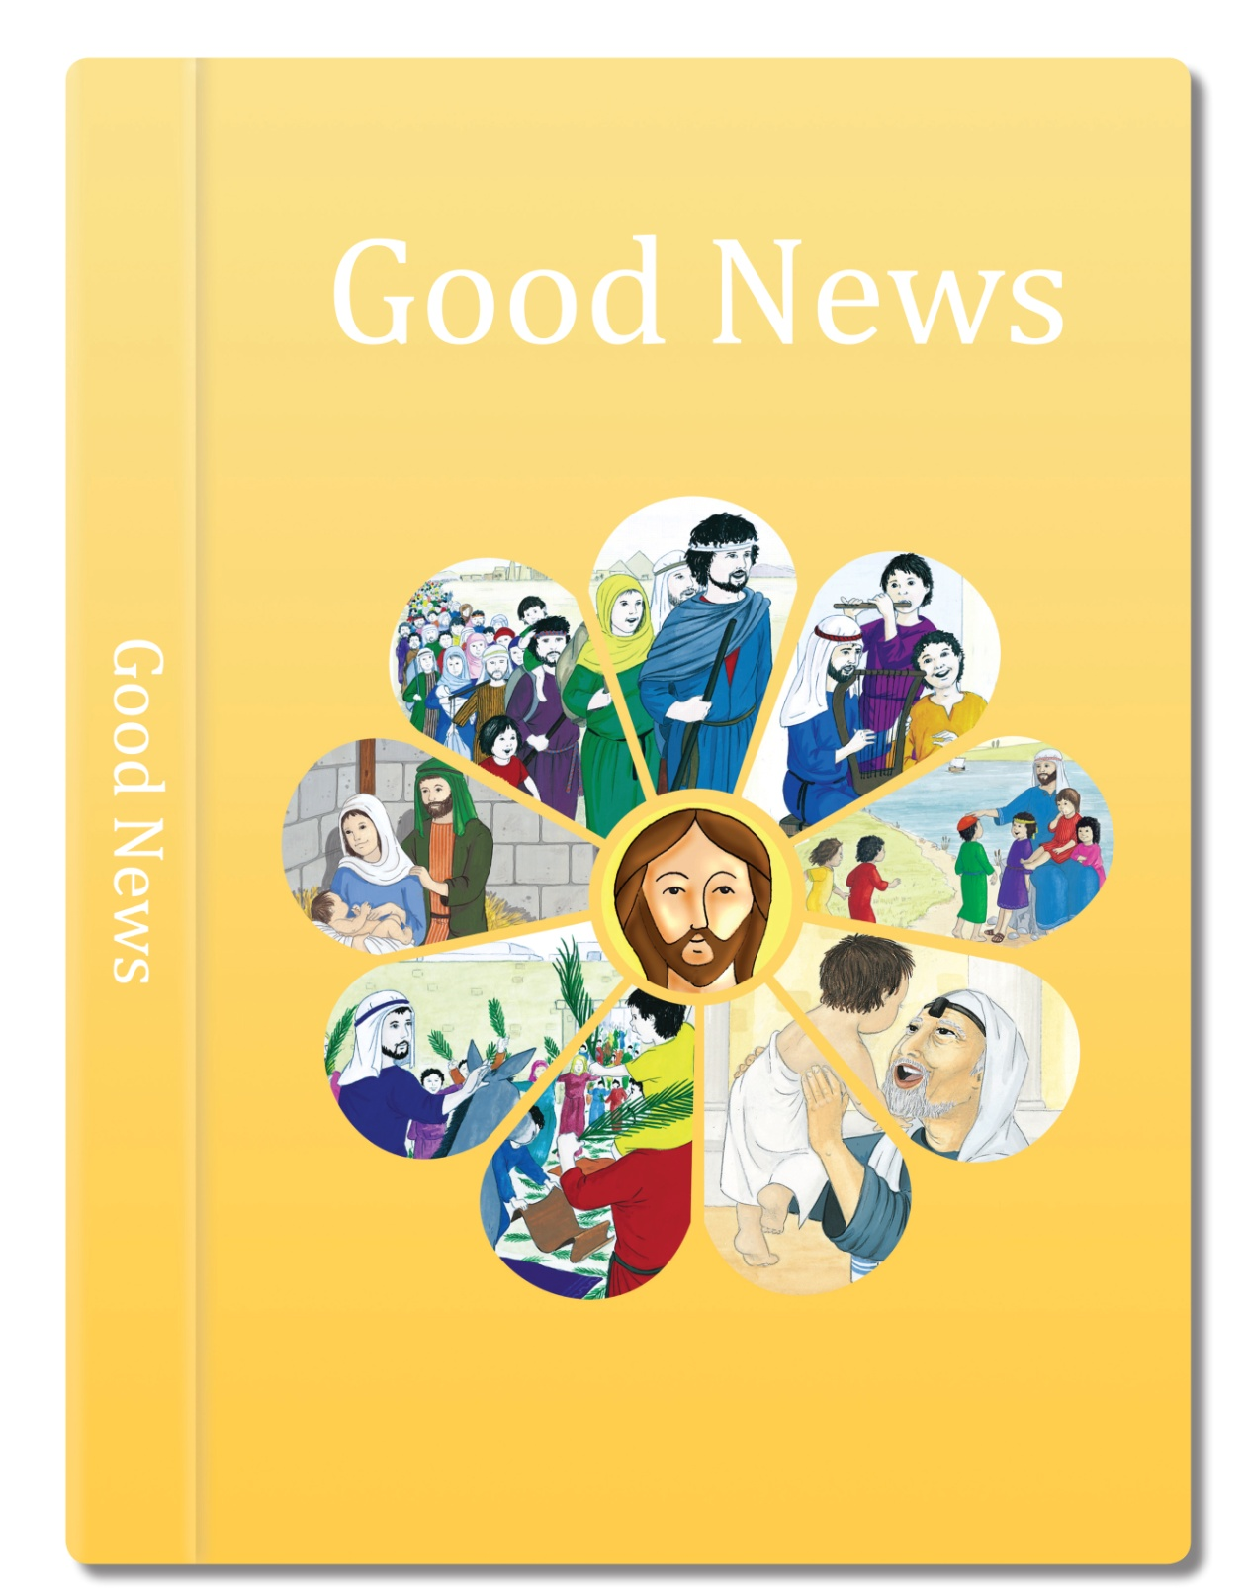
Let’s read from the scripture about Jesus and his special friends:

Slide 12
Jesus and his friends worked very hard. They travelled on rough, dusty roads to towns and villages all over the country.
All day long they told the people in the villages and the towns the Good News of God’s love for everyone.
They answered lots of questions that people asked them about God, sometimes very hard ones.
Sometimes they had to walk a very long way to get from one village to another.

Slide 13
In the evening, they felt very tired. Sometimes they all went to a quiet, lonely place to eat, to share with each other what had happened during the day, to rest, to be quiet and still.
Based on Mark 6: 7, 30-32
God’s Story 2

Slide 14
SOME KEY QUESTIONS TO TALK ABOUT
How do we know they are friends?
What does the picture tell us about friends?
What did Jesus and his friends do? (They worked, told people the Good News of God’s love for everyone, answered questions.)
Where did they go when they were tired?
What did they do together? (eat, shared experiences, rested)
Where do you go when you are tired?
Who do you talk to about your experiences of the day? e.g. what has gone well/what has not.
Where do you go to be quiet and still?

Slide 15
Make a friendship chain.
Write a word to describe friendship on each link.

Slide 16
RECEPTION FOCUS WEEK 2: Jesus’ rule for friends.
I can begin to recognise that Christians show love for one another because Jesus asked them to do so.
I can begin to recognise Jesus’ rule for friends and his words ‘love one another’.
https://www.youtube.com/watch?v=NFeccE4gv8s
Click on the link for the music and sing the song together.
Circle Song
Come and join the circle, come and take my hand. Come and join the circle, come and be my friend.
Gather round and see what the world can be. Come and join the circle, come and share God’s word with me.
Come and join the circle, come and take my hand. Come and join the circle, come and be my friend.
Gather round and see what the world can be. Come and join the circle, come and share God’s word with me.
What does the song
make you wonder about?

Slide 17
Let’s read the scripture and find out about Jesus’ new rule for his friends.

Slide 18
Jesus said, “I’m going to give you a new rule.
When you’re all happy together, everyone will know that you love one another, and that you are my friends.”
It’s this: Love one another. I love each one of you, and I want you to love each other.
Based on John 13: 34-35
God’s Story 2

Slide 19
SOME KEY QUESTIONS TO TALK ABOUT
What is Jesus’ rule?
What will happen when you are happy together?
Why do you like your friends?
What makes a good friend?
What will help to mend the circle?

Slide 20
What is happening
in the picture?
What can the girl do
to mend the friendship?

Slide 21
What do you
think she said?

Slide 22
Use your toys to tell a story
about being sorry and making
friends again.
Can you remember Jesus’ special rule?

Slide 23
RESPOND
Remembering, celebrating and responding to how we can make good friends, that Jesus had good friends and what Jesus tells us about friendship
Remember
Start the session with a moment of quiet reflection. Light a candle and make the sign of the cross. Provide your child with the opportunity to engage with questions of meaning and purpose related to Friends.
Ask your child if there is anything they wonder about
How friends make us feel happy, comfortable and glad.
What breaks and mends friendships.
How Jesus is our friend.
Provide the opportunity for your child to remember
It is good to have friends.
What Jesus tells us about being friends.
Jesus’ new rule for friends.
How we can change and say sorry and forgive each other.

Slide 24
Rejoice
Sing the Circle song again and say a prayer together.
Apply their learning
How can I show friendship or forgiveness to someone today?
Some suggested ideas
Think about some ways to show friendship or forgiveness in your family.
Finish by making the sign of the cross.

