Slide 1
Collective Worship
Week commencing 1 June 2020

Slide 2
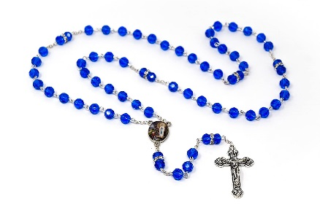
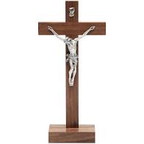
Make sure that you are sitting comfortably and that you are somewhere quiet.
Try to make sure that you will be able to think quietly and without distractions for a few minutes.
If you have one you might like to place a crucifix, a set of rosary beads, a bible, or another religious object next to your screen. Your worship is different to anything else from school that you will do today.
When you are ready, move on to the next slide.

Slide 3
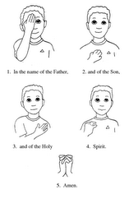
In the name of the Father, and of the Son, and of the Holy Spirit. Amen.

Slide 4
We are now in Ordinary Time.
Sunday was the feast of Pentecost – the coming of the Holy Spirit. In today’s Gospel reading we will hear Jesus instructing his disciples – telling them how the Holy Spirit would help them.

Slide 5
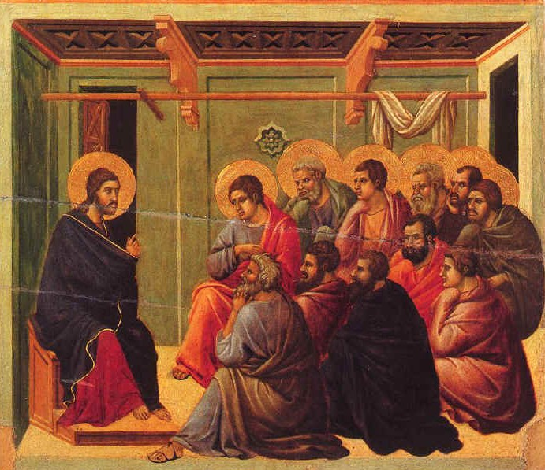
A reading from the Gospel of John
The disciples were afraid of the Jewish leaders, and on the evening of that same Sunday they locked themselves in a room. Suddenly, Jesus appeared in the middle of the group. He greeted them and showed them his hands and his side. When the disciples saw the Lord, they became very happy.
After Jesus had greeted them again, he said,
“I am sending you, just as the Father has sent me.”
Then he breathed on them and said,
“Receive the Holy Spirit. If you forgive anyone’s sins, they will be forgiven. But if you don’t forgive their sins, they will not be forgiven.”

Slide 6
Jesus told his friends that they had a mission. He told them that they were being sent out to do something, and that the Holy Spirit would help them.

Slide 7
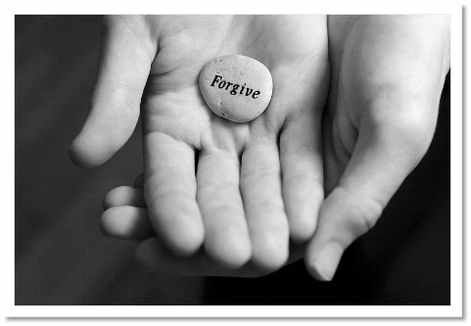
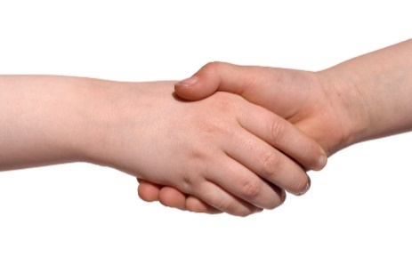
In the reading we have heard, Jesus told his friends to forgive other people.
Can you think of a time when you have forgiven someone else?
Can you think of a time when someone else has forgiven you?
How does it feel when you have ‘made up’ with somebody who has upset you?

Slide 8
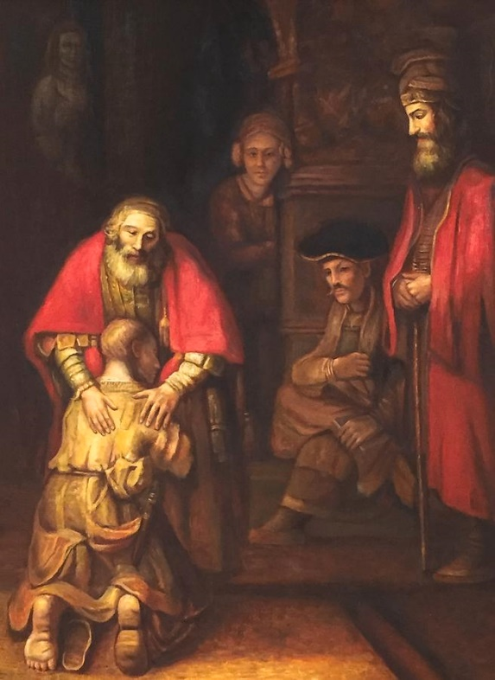
The Gospels contain a number of accounts of Jesus forgiving sinners, and Jesus teaching about the importance of forgiveness.
Here are some examples. Can you think of any others?
The Prodigal Son
The soldiers who put Jesus on the cross
Go to the next slide for some more examples

Slide 9
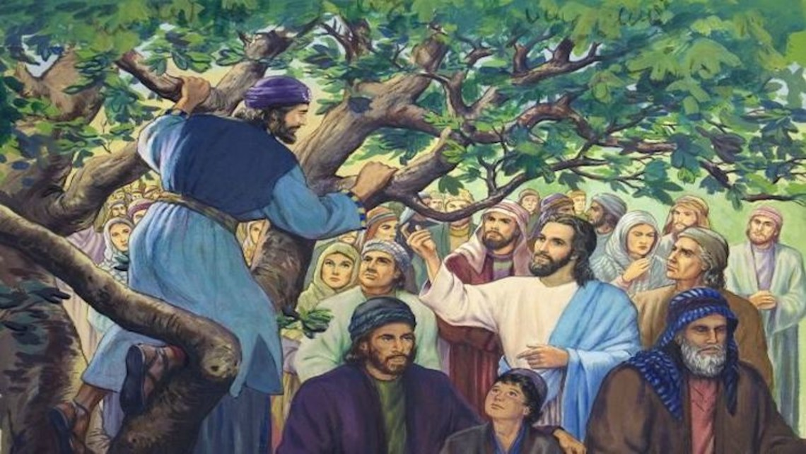
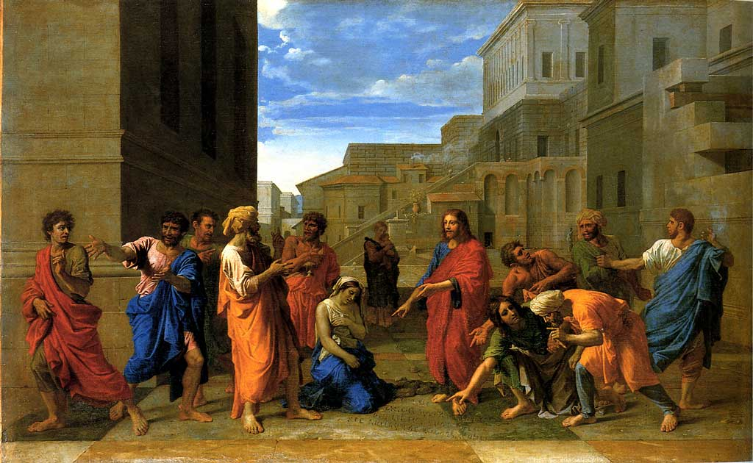
Zacchaeus the tax collector
The woman other people wanted to be put to death

Slide 10
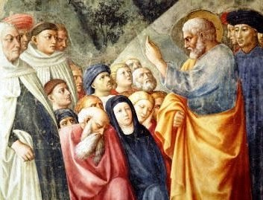
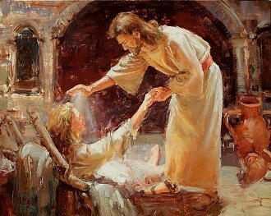
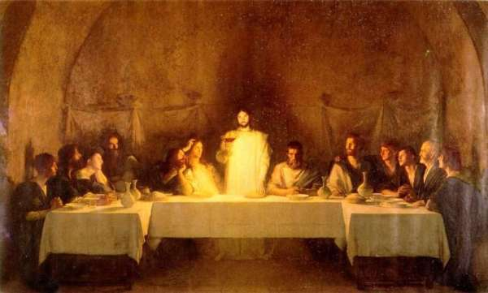
Jesus told his friends that they were being sent out to forgive, with the help of the Holy Spirit.
Jesus wanted them to go out and carry on his work.
He wanted them to baptise.
He wanted them to preach about God.
He wanted them to care for the poor and the sick.
He wanted them to remember him through sharing in the Eucharist.

Slide 11
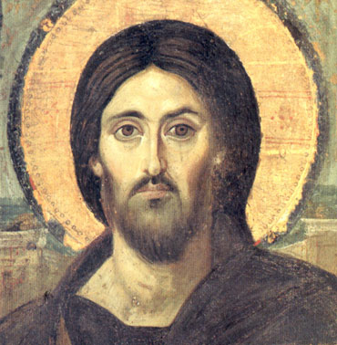
What else did Jesus do during his time on earth that he would have wanted his friends to continue to do?

Slide 12
God sent the Holy Spirit so that Jesus’ friends would not be alone.
The Holy Spirit would:
Help them know what words to say
Guide them so they knew where to go
Comfort and protect them and give them courage
Help them to remember that God was with them
Give them energy and determination
Help them to be fair and make good decisions

Slide 13
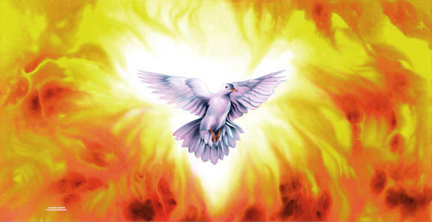
Almost 2000 years ago, Jesus spoke to his friends before he ascended into Heaven. The Holy Spirit came.
Jesus promised that the Holy Spirit would come not only then, but ever since, now and in the future, to help anyone who loves Jesus, and wants to do Jesus’ work on earth.
The Holy Spirit is a gift FROM God for you and me.
The Holy Spirit is a gift OF God for you and me.

Slide 14
What can you do today to try to do God’s work on earth? The Holy Spirit will help.
Is there someone you need to forgive, or do you need to say sorry to anyone else?
Is there a family member or a friend who you can be especially helpful and cheerful towards?
What choices do you have to make today? Could you ask the Holy Spirit to guide you?
What ideas have you got about ways the Holy Spirit could help you today?

Slide 15
Here is a song to listen to or join in with. It is a reminder that it is up to us to do God’s work on earth … but remember that the Holy Spirit is here to help us.

Slide 16
Prayer
Let us be still and silent for one minute. Let us think of someone or something we would like to pray for or about today.
Let us pray for those who are sick or lonely or anxious or afraid; those who have died; those who mourn because someone they love has died; those far away from home; those who feel that they have no-one else to pray for them. Let us pray that their lives may be touched today by the loving hand of God. Amen.

Slide 17
Share a prayer
Dear God, thank you for the gift of your Holy Spirit. I pray that when I am not sure what to say or what decisions to make I will ask the Holy Spirit to guide me. I pray that the Holy Spirit will always help me to stay close to God, and to do your work on earth.
Amen.

Slide 18
In the name of the Father, and of the Son, and of the Holy Spirit. Amen.

