Slide 1
Collective Worship
Week commencing 8 June 2020

Slide 2
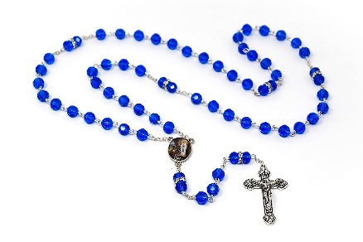
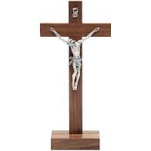
Make sure that you are sitting comfortably and that you are somewhere quiet.
Try to make sure that you will be able to think quietly and without distractions for a few minutes.
If you have one you might like to place a crucifix, a set of rosary beads, a bible, or another religious object next to your screen. Your worship is different to anything else from school that you will do today.
When you are ready, move on to the next slide.

Slide 3
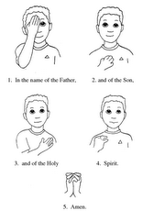
In the name of the Father, and of the Son, and of the Holy Spirit. Amen.

Slide 4
We are in Ordinary Time.
Sunday was the feast of The Holy Trinity – God the Father, God the Son and God the Holy Spirit.

Slide 5
A reading from the Gospel of John
Jesus told Nicodemus:
“God loved the people of this world so much that he gave his only Son, so that everyone who has faith in him will have eternal life and never die.
God did not send his Son into the world to condemn its people. He sent him to save them!”

Slide 6
The reading we have shared has a clear message from God:

Slide 7
What do you think ‘love’ is?
How do you show love towards others in your family?
How do you show love towards your friends?
How do you show love towards everyone else at school?
How do you show love towards neighbours, and people you do not know by name?

Slide 8
Whatever we may do, God will always love us.
God’s love is:
a gift
for everyone, equally
unconditional
limitless
everlasting

Slide 9
God’s love is:
a gift
for everyone, equally
unconditional
limitless
everlasting
Let’s explore each of these …

Slide 10
A gift
God chooses to love us.
Thank you God for the gift of love. Thank you for embracing us with your love.

Slide 11
For everyone, equally
God does not love some people more than others. God loves everyone exactly the same.
Thank you God for showing me that I am special in your eyes.

Slide 12
Unconditional
Whatever choices we make, God will still love us the same. Of course God wants us to make good choices, but even if we do something that upsets God, it will not make Him love us any less.
Thank you God for helping me know that even if I sometimes make the wrong choices it will not stop you loving me.

Slide 13
Limitless
God’s love cannot be measured. It is never-ending!
Thank you God for love that overflows! Thank you for helping me know that your love can never run out.

Slide 14
Everlasting
God’s love starts before we have even been born, stays with us through our lives, and remains with us after we have died. It never ends.
Thank you God for being with me, always.

Slide 15
Here is a lovely song to listen to or join in with: ‘Love, love, Jesus is love; God’s greatest gift is the gift of love’

Slide 16
There is no more important message than ‘God loves you’. God loves you. God loves me. God is love.
Let’s try to take that message into our hearts, and share it with other people.

Slide 17
Let’s remember too that we are born to be like God. We are born to show God’s love in our faces. God is calling us to smile, and to share his love.

Slide 18
Share a prayer
Dear God, thank you for the love you have for me. Help me today to share that love with my family, my friends, and with everyone I meet. Help me, Lord, to try to love you as much as you love me.
Amen.

Slide 19
In the name of the Father, and of the Son, and of the Holy Spirit. Amen.

