Slide 1
Year 5 – Summer - Block 5
Volume

Slide 2
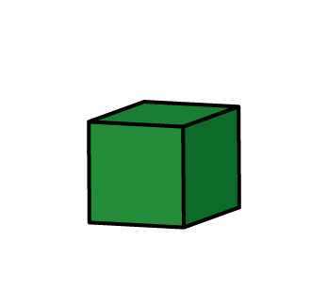
How many possible ways can you make a cuboid that has a volume of 12cm³?

Slide 3
My shape is made up of 10 centimetre cubes.
The height and length are the same size.
What could my shape look like?
Create your own shape and write some clues for a partner.

Slide 4
Shape A has a height of 12 cm. Shape B has a height of 4 cm.
Dora says Shape A must have a greater volume.
Is she correct? Explain your answer.

Slide 5
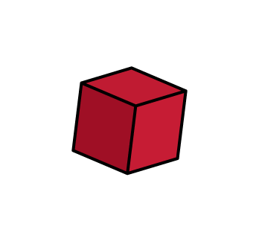
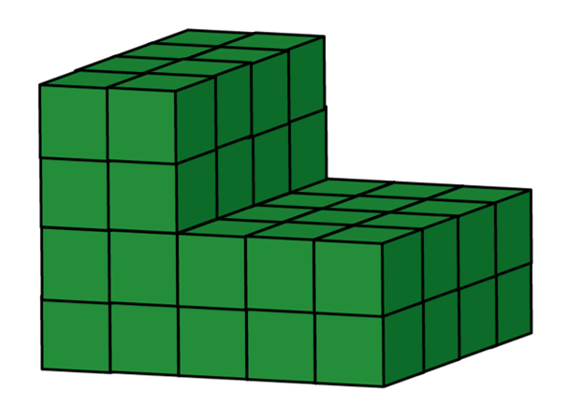
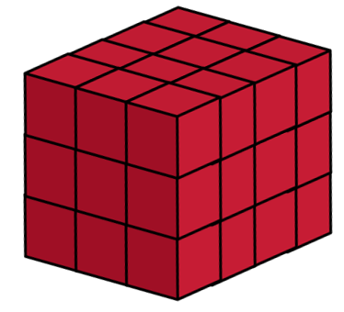
Amir, Whitney and Mo all build a shape using cubes.
Mo has lost his shape, but knows that it’s volume was greater than Whitney’s, but less than Amir’s.
Amir’s Whitney’s
What could the volume of Mo’s shape be?

Slide 6
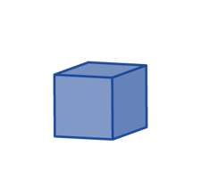
Eva has built this solid:
Tommy has built this solid:
Eva thinks that her shape must have the greatest volume because it is taller.
Do you agree?
Explain your answer.

Slide 7
Each of the cubes have a volume of 1 m³
The volume of the whole shape is between 64 m³ and 96 m³
What could the shape look like?

Slide 8
Jack is using cubes to estimate the volume of his money box.
He says the volume will be 20 cm³
Do you agree with Jack?
Explain your answer.
What would the approximate volume of the money box be?
MONEY

Slide 9
Give children a container.
Using rice, water and cotton wool balls, can children estimate how much of each they will need to fill it?
Discuss what is the same and what is different.
Will everyone have the same amount of cotton wool?
Will everyone have the same amount of rice?
Will everyone have the same amount of water?

Slide 10
Give children a container.
Using rice/water and a different container e.g. cups, discuss how many cups of rice/water we will need to fill the containers.
Link this to the capacity of the containers.

